Slide 1

Royal Rental

Slide 2



Tech Stacks
Royal Rental

Slide 3
Royal Rental
Tech Stacks

Slide 4
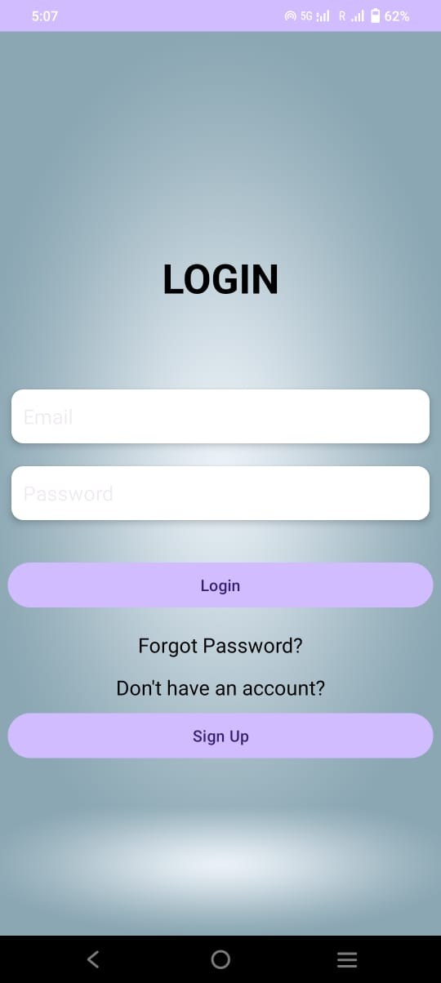
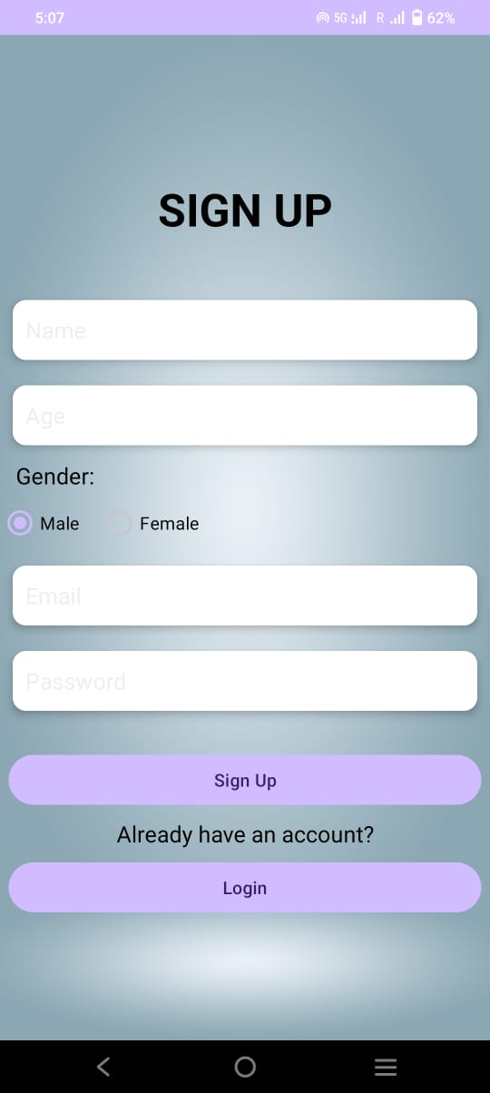
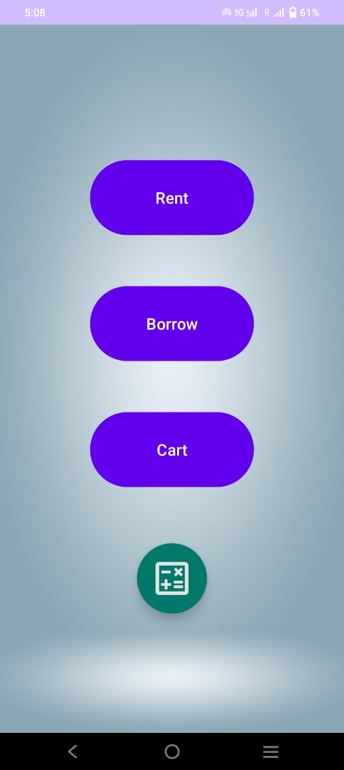
Tech Stacks
Royal Rental
Authentication
Login
Sign Up
Email Services for Forget Password

Slide 5
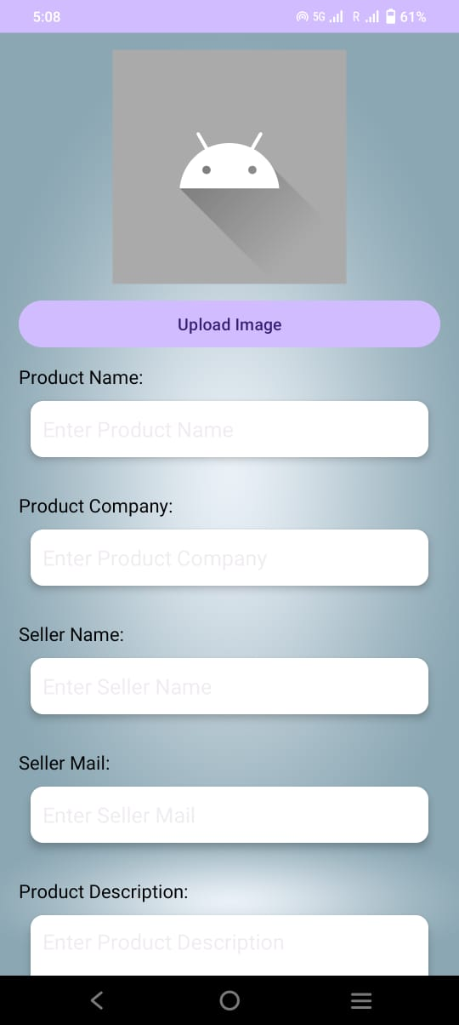
Royal Rental
HOME SCREEN
Clean interface for users to select their tool category and explore options easily.

Slide 6
Royal Rental
Rent
You can add the details of the tool that you want to rent to others.

Slide 7
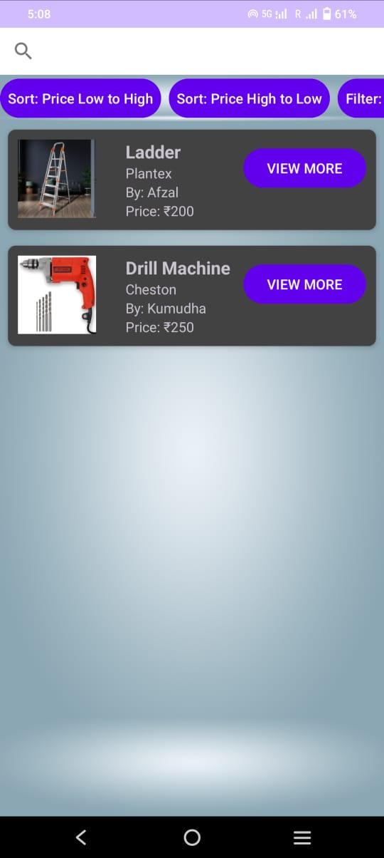
Royal Rental
Want tools?
Rent any tool with just a few taps.
Easy browsing, availability checks, and sorting options.

Slide 8
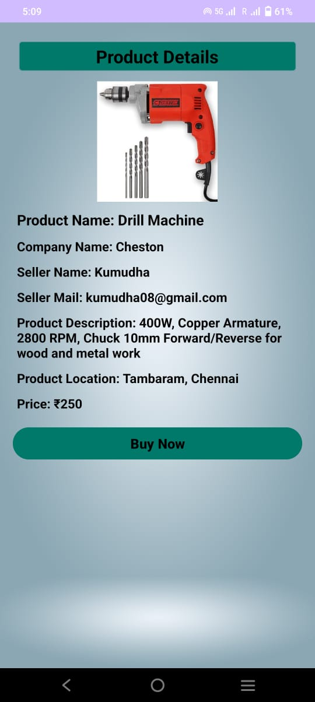
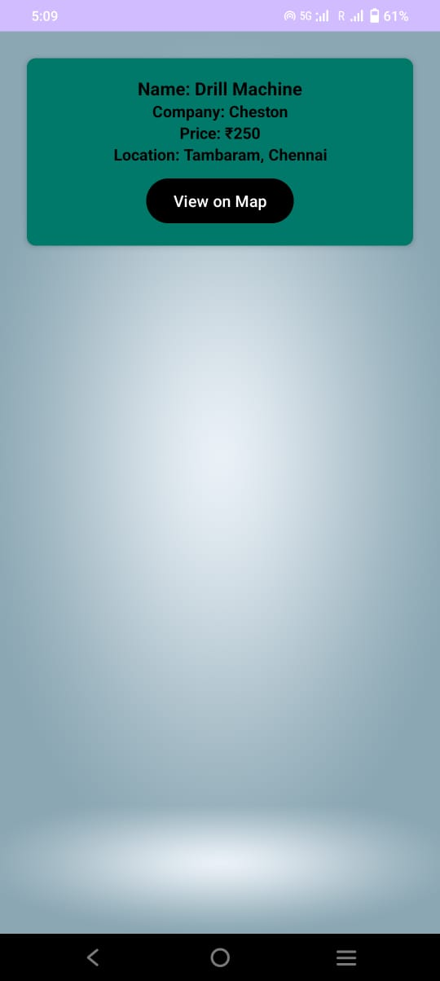
Royal Rental
Borrow IT
Need a tool? Just borrow it!
Transparent process, no hidden conditions.

Slide 9
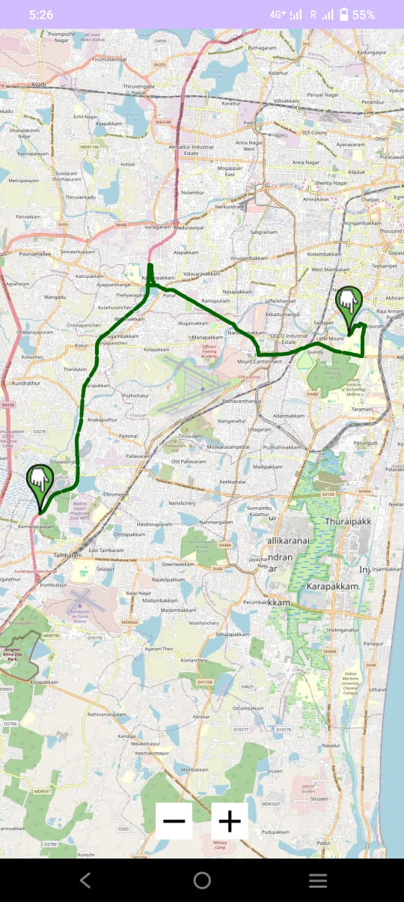
Royal Rental
Track your Tool
Once rented, track the delivery status in real time.
Know the current location of your tool.

Slide 10
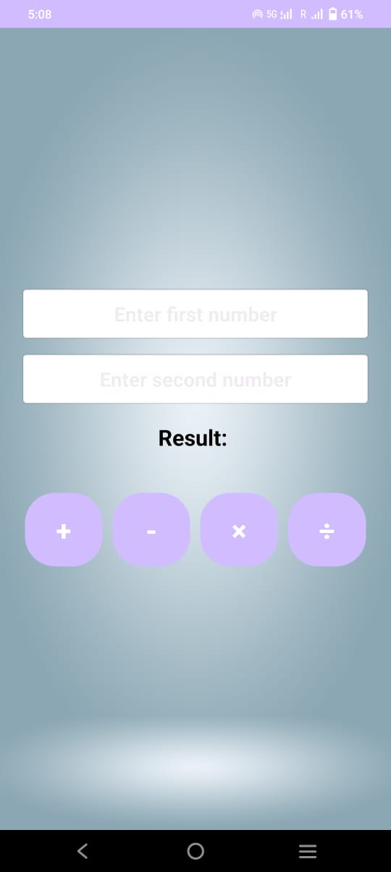
Royal Rental
Simple calculator
Thank You
Quick rent estimation using a built-in calculator.
Know the cost before you confirm.

Slide 11
Thank You

